Slide 1
Chapter 15
Building an Awesome Todo List App in React

Slide 2
Objectives
Creating the Initial UI
Building the Rest of the App
Adding Items
Displaying the Items
Styling our App
Removing Items
Animation! Animation! Animation!

Slide 3
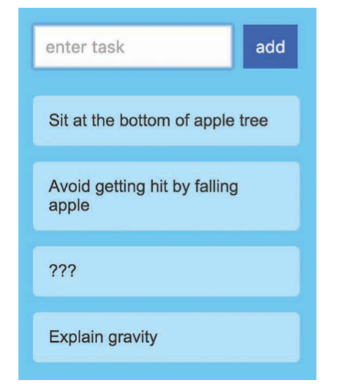
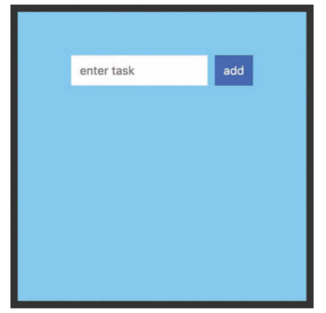
Creating the Initial UI
The way this Todo List app works is pretty simple. You type in a task or item or whatever you
want into the input field and then press Add (or click Enter/Return). After you’ve submitted
your item, you’ll see it appear as an entry.

Slide 4
Building the Rest of the App
As you can imagine, getting the initial UI elements to show up is the easy part. Tying up all the visuals with the underlying data is where the real work lies. This work can roughly be divided into five parts:
1. Adding items
2. Displaying items
3. Styling
4. Removing items
5. Animating items as they are added or removed
Individually, all of these little implementation details are easy to wrap your brain around.
When you put them together, you need to watch out for a few things. We’ll look at all that and more in the following sections.

Slide 5
Animation! Animation! Animation!
Fortunately, the React community has come up with a handful of lightweight animation libraries that make animating adding and deleting elements really easy.
One such library is Flip Move. Among many things, this library makes animating the addition and removal of list elements simple.
To use this library, we need to first add it to our project. From the command line, make sure you are still in the same location as our todolist project and run the following command:
npm i -S react-flip-move
Click Enter/Return to copy all the necessary things locally into our project’s node_modules folder. That’s all the setup required. After you’ve done this, in TodoItems.js , add the following import statement at the top:
import FlipMove from 'react-flip-move'

Slide 6
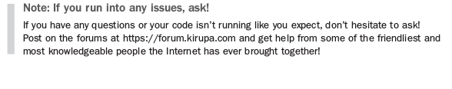
Conclusion
Our Todo app is pretty simple in what it does, but by building it from scratch, we covered almost every little interesting detail React brings to the table. More important, we created an example that shows how the various concepts we learned individually play together. That’s truly actually the important detail

